Slide 1
FETAL HEALTH CLASSIFICATION
VELLORE ISTITUTE OF TECHNOLOGY,
CHENNAI , INDIA.
ANANTHARAMAN J
RATHAKRISHNAN R K
NANDHINI M
BEULAH S

Slide 2
INTRODUCTION
Reduction of child mortality is reflected in several of the United Nations' Sustainable Development Goals and is a key indicator of human progress.
Parallel to notion of child mortality is of course maternal mortality, which accounts for 295 000 deaths during and following pregnancy and childbirth (as of 2017).
Prediction of fetal health state from the dataset using machine learning models if the fetal is healthy or unhealthy.
The datset consist of 2126 measurements extracted from cardiotocograms with 22 attributes.

Slide 3
OBJECTIVE
By 2030 , the UN expects that the countries end preventable deaths of newborns and children under 5 years of age.
Child mortality is of course maternal mortality, which accounts for 295 000 deaths during and following pregnancy and childbirth (as of 2017).
Cardiotocograms (CTGs) are a simple and cost accessible option to assess fetal health, allowing healthcare professionals to take action in order to prevent child and maternal mortality.
The equipment works by sending ultrasound pulses and reading its responses shedding light on fetal heart rate , movements and more.

Slide 4
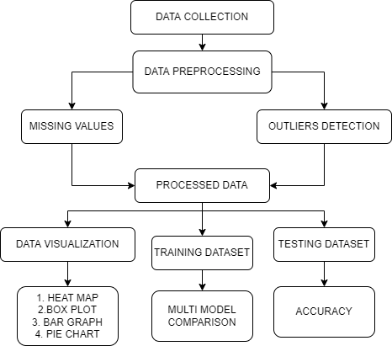
METHODS TO USE :

Slide 5
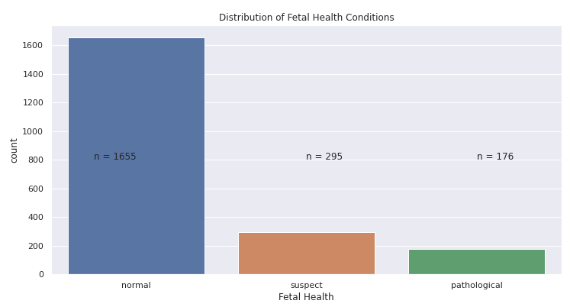
FETAL HEALTH CONDITIONS

Slide 6
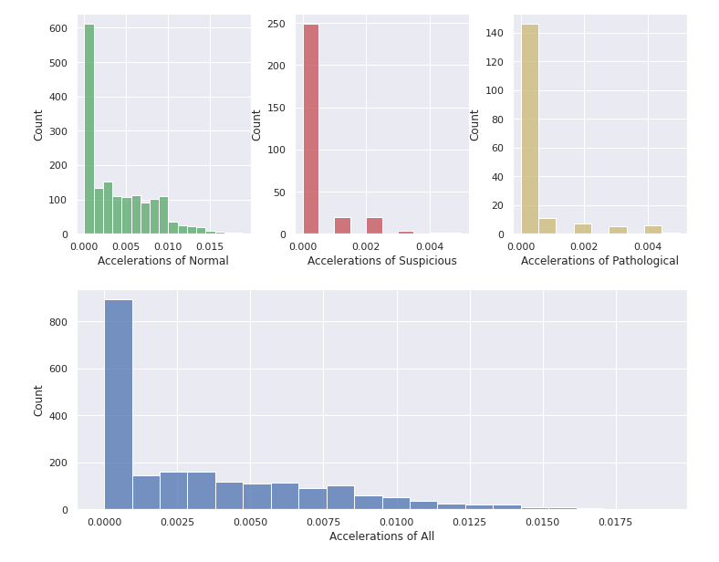
ACCELERATIONS

Slide 7
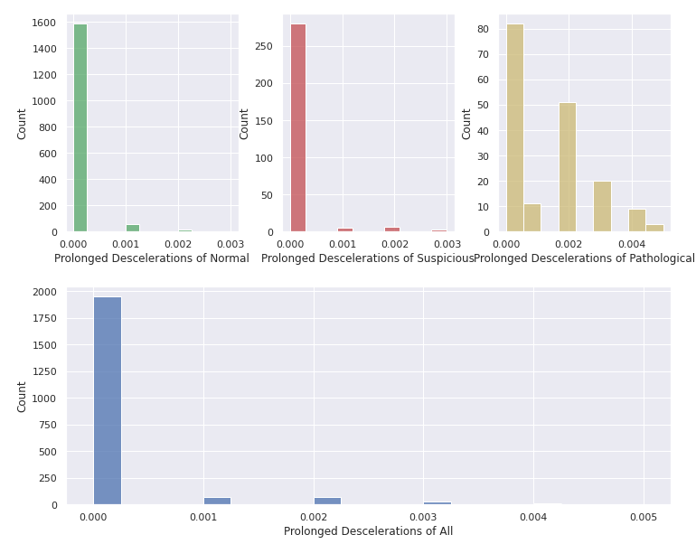
PROLONGED DECELERATIONS

Slide 8
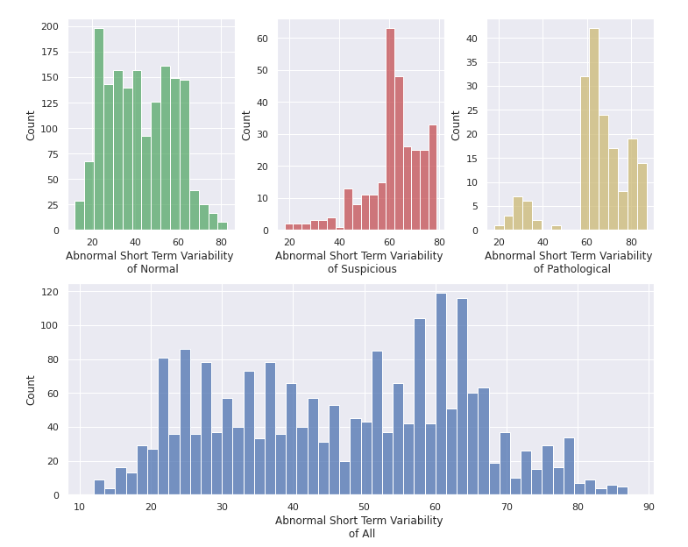
ABNORMAL SHORT TERM VARIABILITY

Slide 9
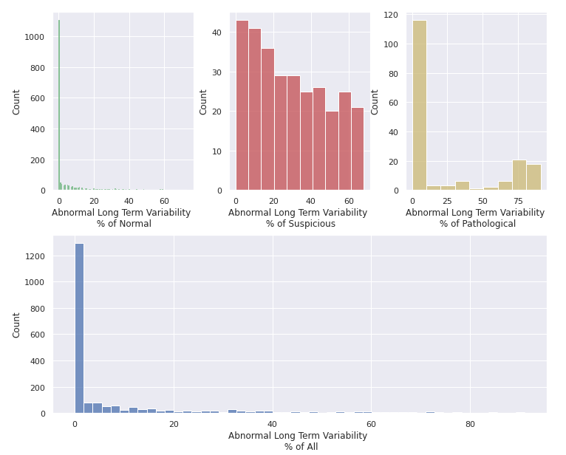
ABNORMAL LONG TERM VARIABILITY

Slide 10
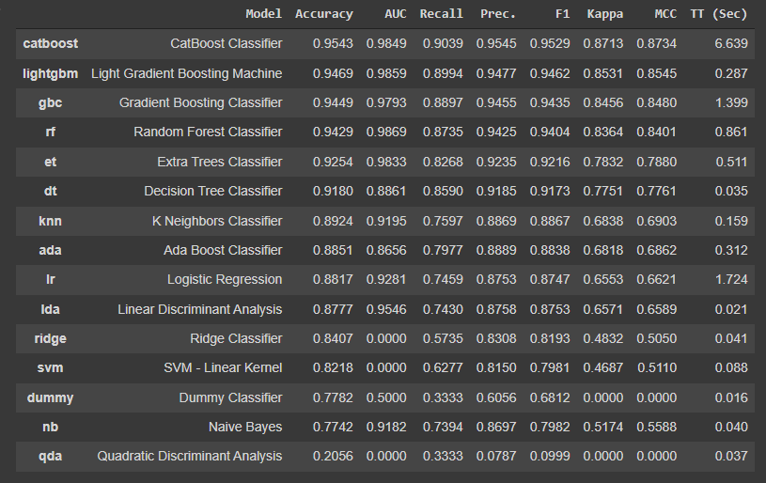
MODELS USED

Slide 11
BEST PERFORMED MODELS
CatBoost Regressor
Extra Trees Regressor
Random Forest Regressor
Light Gradient Boosting Machine
Gradient Boosting Regressor

Slide 12
REFERENCES
1.Robinson, B.: A review of nichd standardized nomenclature for cardiotocography: the importance of speaking a common language when describing electronic fetal monitoring. Reviews in Obstetrics and Gynecology 1(2), 56 (2008)
2.Alfirevic, Z., Devane, D., Gyte, G.M., et al.: Continuous cardiotocography (ctg) as a form of electronic fetal monitoring (efm) for fetal assessment during labour. Cochrane Database Syst. Rev. 3 (2006)
3.Macones, G.A., Hankins, G.D., Spong, C.Y., Hauth, J., Moore, T.: The 2008 national institute of child health and human development workshop report on electronic fetal monitoring: update on definitions, interpretation, and research guidelines. Journal of Obstetric, Gynecologic, & Neonatal Nursing 37(5), 510–515 (2008)

Slide 13
4.Kupka, T., Wrobel, J., Jezewski, J., Gacek, A.: Evaluation of fetal heart rate baseline estimation method using testing signals based on a statistical model. In: 28th Annual International Conference of the IEEE Engineering in Medicine and Biology Society, EMBS 2006, August 30-September 3, pp. 3728–3731 (2006)
5.Ocak, H., Ertunc, H.: Prediction of fetal state from the cardiotocogram recordings using adaptive neuro-fuzzy inference systems. Neural Computing and Applications, 1–7 (2012)

